Slide 1
Engaging KS3/4 students with AI and Python Code
Mark Weddell
City of London School for Girls
This presentation is available today at
www.weddell.co.uk

Slide 2

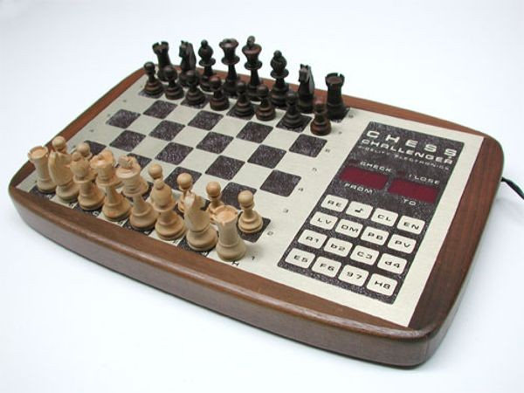

My first AI experiences

Slide 3
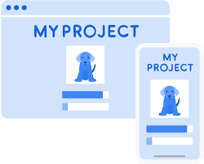

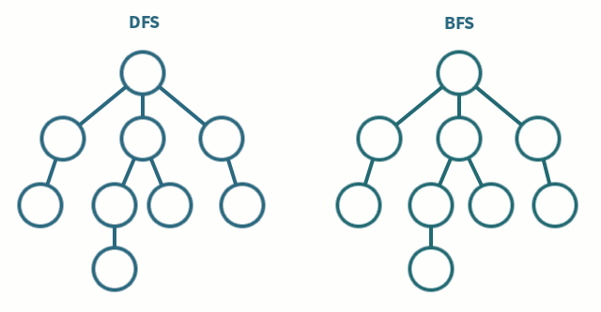
Early Teaching AI experiences
Gather, Train, Use…
Machine Learning for Kids
Teachable Machine
AQA 4.3 - Graph Traversal and Optimisation Algorithms

Slide 4
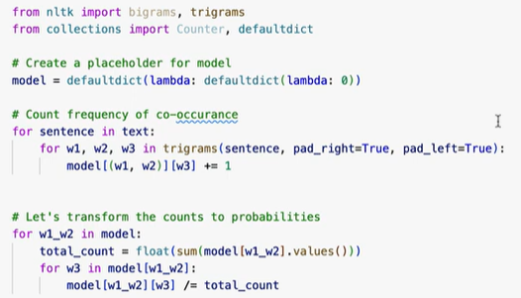
Inspiration – CAS Conference 2024
Miles Berry - 3 July 2024 AI and Computing Education,
workshop for Computing At School conference, ADA College.

Slide 5
Why with KS3/4?
Most AI experiences remove the coded complexity of “reasoning” from students.
Algorithms for GCSE are fairly basic and seem far removed from equipping …
“… pupils to use computational thinking and creativity to understand and change the world.”
UK Teacher Standards encourage us to …
“Set high expectations which inspire, motivate and challenge pupils”
Your setting…

Slide 6
My Three Examples
Algorithmic AI - Rule-based Systems
Data Driven AI – Human in the Loop (HITL)
Data Driven AI - Automated Playtesting

Slide 7

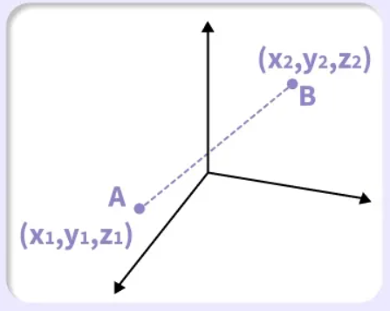
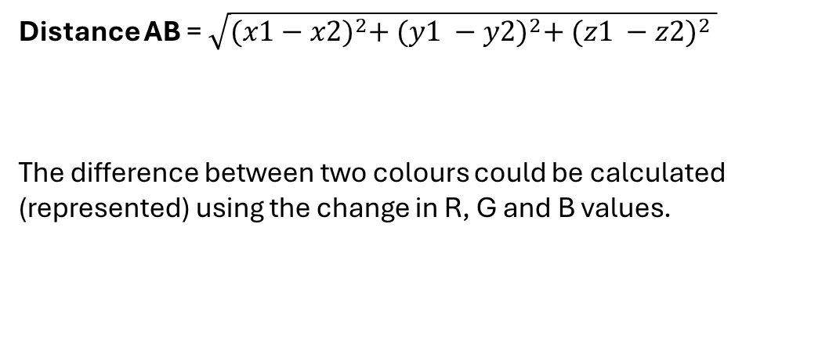
Colour Matching – Near Neighbour
- Algorithmic AI
Distance AB =$\sqrt{{(x1−x2)}^{2}+ {(y1 −y2)}^{2}+ {(z1 −z2)}^{2} }$
The difference between two colours could be calculated (represented) using the change in R, G and B values.
https://trinket.io/pygame/cace981cbd91

Slide 8
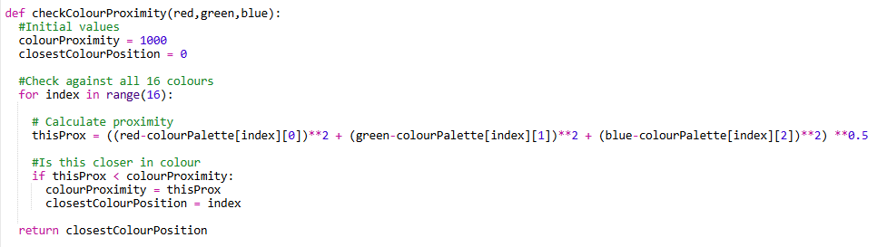
The Code
A ‘minimum’ in list function
combined with 3D Pythagoras calculation
Check each colour in the list.
Work out proximity of this colour.
If the proximity is less than current colourProximity…
Set new colourProximity and closestColourPosition
https://trinket.io/pygame/cace981cbd91

Slide 9
Tasks
Ideas…
As they are lists in Python, you can add a name as a string to each colour list.
Print the name of the nearest colour.
Find the nearest two colours, so the user can choose the closest.
Imagine the numbers represent other values on a scale, such as musical tastes, personality traits, etc.
How could you adapt the concept? Instead of 3 values, perhaps 4?
Think …
Are there limitations with this algorithm of near neighbour algorithm?
When would you use it, and when not?
Could this develop to K-Near Neighbour and K –Means Clustering ?
https://trinket.io/pygame/cace981cbd91

Slide 10
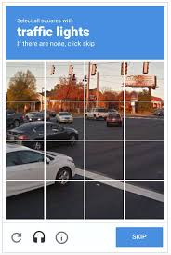
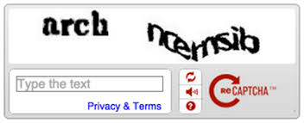
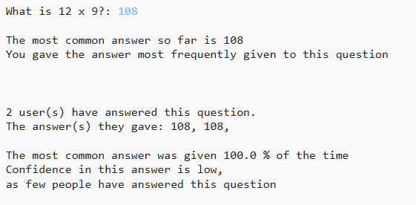
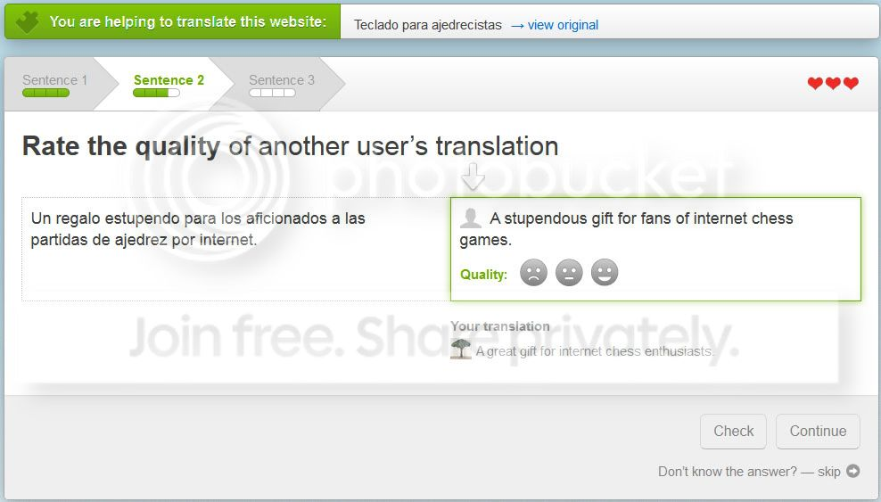
Multiplication Tables – HITL
- Machine Learning AI
The idea that a computer can learn and become more accurate as millions of users attempt to answer questions.
Instead of correct answers, users might receive a reward or gain feedback about their answer…
https://trinket.io/python3/775333af4d6d

Slide 11

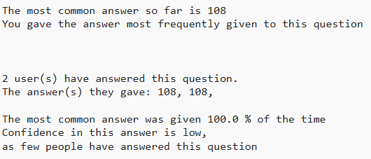
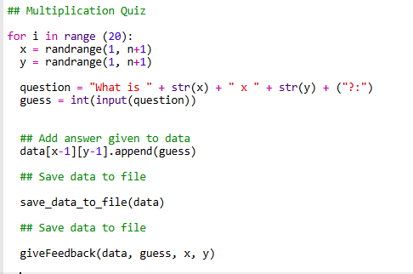
The Code
Ask Question
Get answer from User
Add to data and save
Feedback about answers to same question
https://trinket.io/python3/775333af4d6d

Slide 12
Tasks
Ideas…
The data is currently mostly correct.
Investigate what happens when you get an answer wrong. How does the data change?
Change the feedback.
What other questions could you ask people to gather data about?
Would this work for a country / capital quiz?
Think …
How could you ensure that people aren’t entering malicious answers?
What sort of data does this work for? Bias?
Is there a difference between the data that can and cannot be collected in this way?
https://trinket.io/python3/775333af4d6d

Slide 13
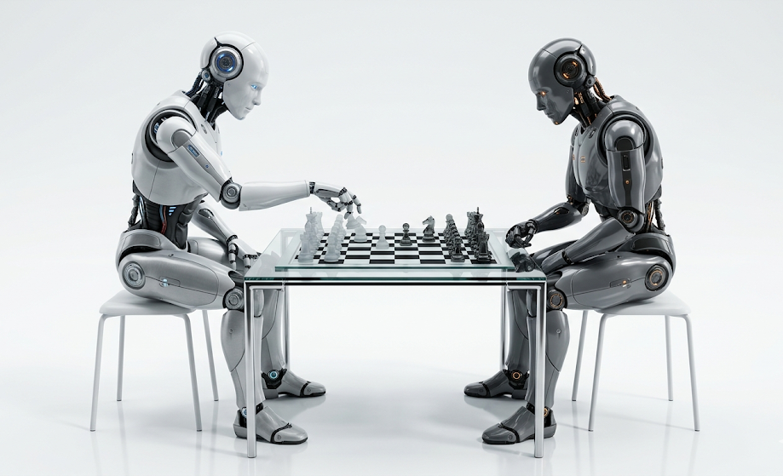
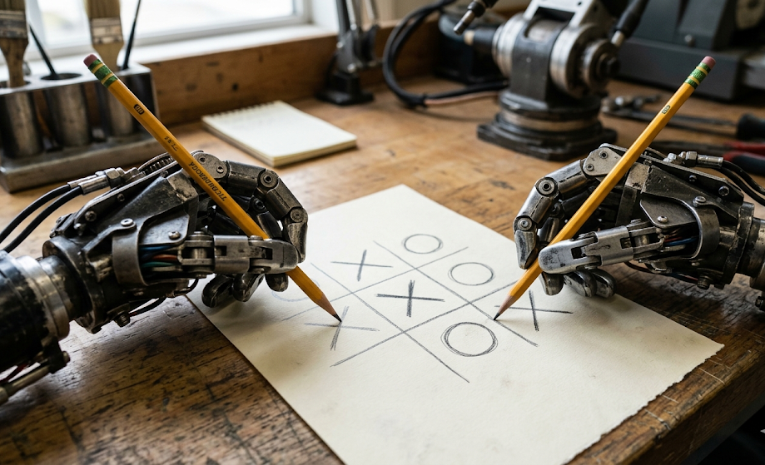
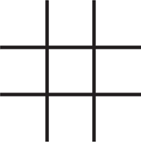
Tic Tac Toe – Computer Generated Data
- Machine Learning AI
Given a set of rules as to how to play, a computer can play thousands or millions of times.
By analysing moves, can the computer predict good choices?
X
O
O
O
2
2
X
X
X
https://trinket.io/library/trinkets/21ac43e94c79

Slide 14
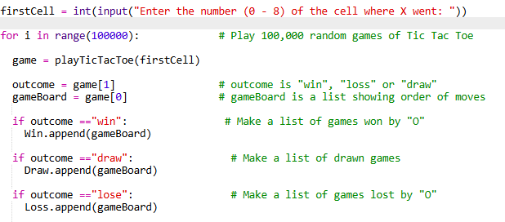
Tic Tac Toe – Computer Generated Data
- Machine Learning AI
Ask for a starting move from your opponent
Play thousands of games from that point
For each game…
  Record whether ‘O’ won, lost or drew
  Record the order of moves made
  Add the order of moves to an array of wins, of draws or losses
Produce statistics of how many games won and lost for each next move.
https://trinket.io/library/trinkets/21ac43e94c79

Slide 15
Tic Tac Toe – Computer Generated Data
- Machine Learning AI
Ideas…
Investigate different starting positions for X
Produce the analysis of the “Loss” list to see bad places to go.
Instead of just one first move, keep entering moves until number 9 is entered, to allow analysis from different positions.
Improve the game playing engine. At present, moves are made completely randomly.
If the algorithm could spot winning or losing moves, do the stats change?
Think …
What sort of situations apart from games could this work for?
What are the pitfalls of this approach?
https://trinket.io/library/trinkets/21ac43e94c79

Slide 16
Would you use these ideas with students?
How? When?
Why? Why not?
Is this useful?
What would you change?

Slide 17
Thank you
www.weddell.co.uk

